Slide 1
Hospital managment system
By:
DINESH KUMAR
HARIPRASATH
SATHISHKUMAR
RAMKUMAR

Slide 2
TOPICS
ABSTRACT
OBJECTIVE
SYSTEM CONFIGURATION
WHY WE CHOOSE PYTHON
WHY WE CHOOSE MYSQL
ER-DIAGRAM
LIBRARIES AND FUNCTIONS USED
OUTPUT

Slide 3
Abstract:
Hospital management system project is developed using Python and MYSQL Database.This application provides an easy way for the receptionist in adding,updating,searching the details of the Patient,Doctor,Ambulance Driver.Hospital management systemin Python is a simple console application.In this project,users can perform typical management related function like adding a new doctor,patient and Ambulance Driver,displaying,modifying and editing it

Slide 4
OBJECTIVE
TO FACILITATE RECEPTIONIST IN HOSPITAL
:
TO STORE PATIENT DETAILS AND RETRIVE USING PATIENT_ID.
TO STORE DOCTOR DETAILS AND RETRIVE USING DOCTOR_ID.
TO STORE AMBULANCE DRIVERS DETAILS AND RETRIVE USING AMB_ID.

Slide 5
System configuration
HARDWARE CONFIGURATION
Microsoft windows 7 professional/windows 8/windows 8.2:
Processor : Intel Core i3 orequivalent
Memory : 2 GB (32-bit), 4 GB(64-bit)
Disk space : 1.5 GB of free diskspace
SOFTWARE REQUIREMENTS
1 GB RAM (2 GB+recommended)
9-58 GB free hard disk space depending on edition and configuration, including space required for temporaryfiles
DVD-ROM drive (if installing from a Media KitDVD)
Basic GPU – Any vendor DirectX 9.0 class or better (Pixel Shader Level2)
Intel® Pentium® or compatible, 1.6 GHz minimum (2GHz+recommended)
1024x768 or higher-resolutionmonitor
MOUSE OR OTHER POINTINGDEVICE

Slide 6
Why we choose python
Python is Portable
Because Python code is interpreted and not compiled into native machine instructions, code written for one platform will work on any other platform that has the Python interpreter installed. (This is true of any interpreted language, not just Python.)
Python is Simple
As programming languages go, Python is relatively uncluttered, and the developers have deliberately kept it that way.A rough estimate of the complexity of a language can be gleaned from the number of keywords or reserved words in the language. These are words that are reserved for special meaning by the compiler or interpreter because they designate specific built-in functionality of the language.Python 3 has 33 keywords, and Python 2 has 31. By contrast, C++ has 62, Java has 53, and Visual Basic has more than 120, though these latter examples probably vary somewhat by implementation or dialect.

Slide 7
Why we choose myssql
High Performance –Provides fast load utilities with distinct memory caches and table indexpartitioning.
Low Total Cost Of Ownership –This reduces licensing costs and hardware expenditures.
Open Source & 24 * 7 Support –This RDBMS can be used on any platform and offers 24*7 support for open source and enterpriseedition.
Secure Data Protection –MySQL supports powerful mechanisms to ensure that only authorized users have access to thedatabases.
High Availability –MySQL can run high-speed master/slave replication configurations and it offers clusterservers.
Scalability & Flexibility –With MySQL you can run deeply embedded applications and create data warehouses holding a humongous amount ofdata.

Slide 8
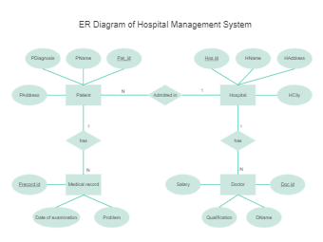
ER-DIAGRAM:

Slide 9
LIBRARIES AND FUNCTIONS USED
Mysql.connector-TO CONNECT DATABASE MANAGMEANT SYSTEM TABLE WITH PYTHON AND TO RETRIEVE THE DATA FROM TABELS
IMPORT TKINTER AS TK: IN PYTHON FOR
GUI

Slide 10
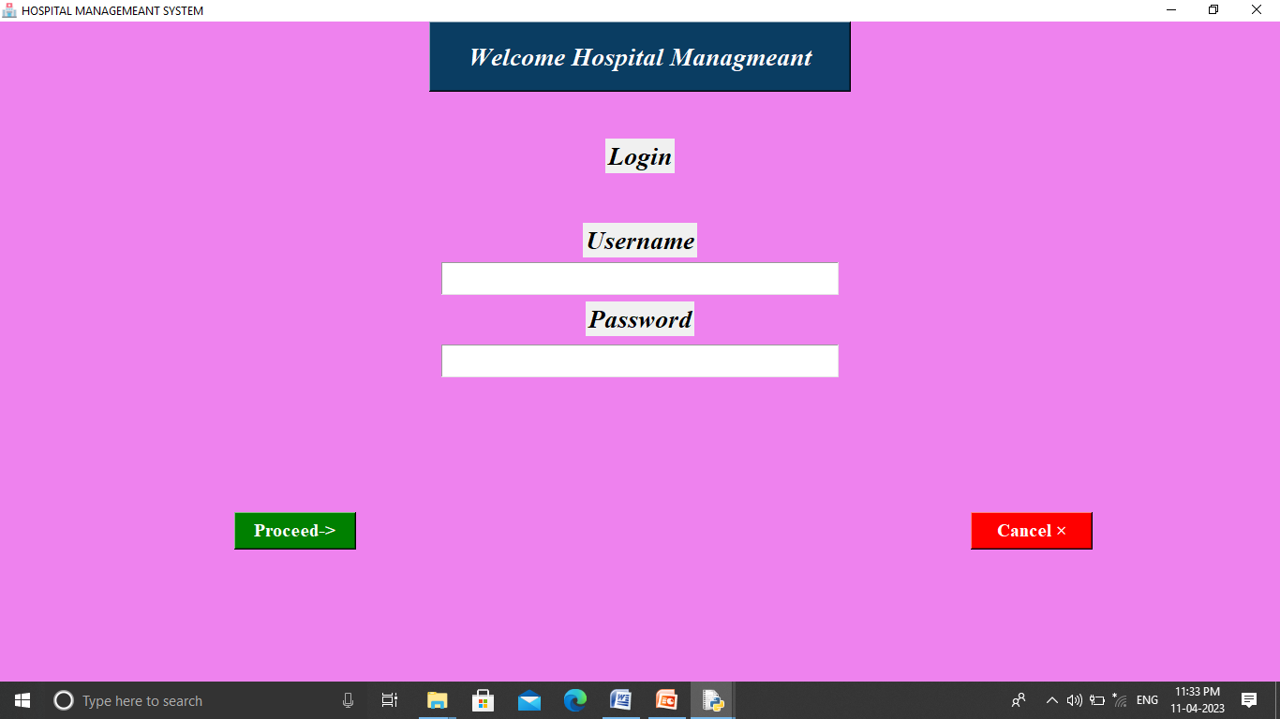
SCREENSHOTS LOGIN PAGE

Slide 11
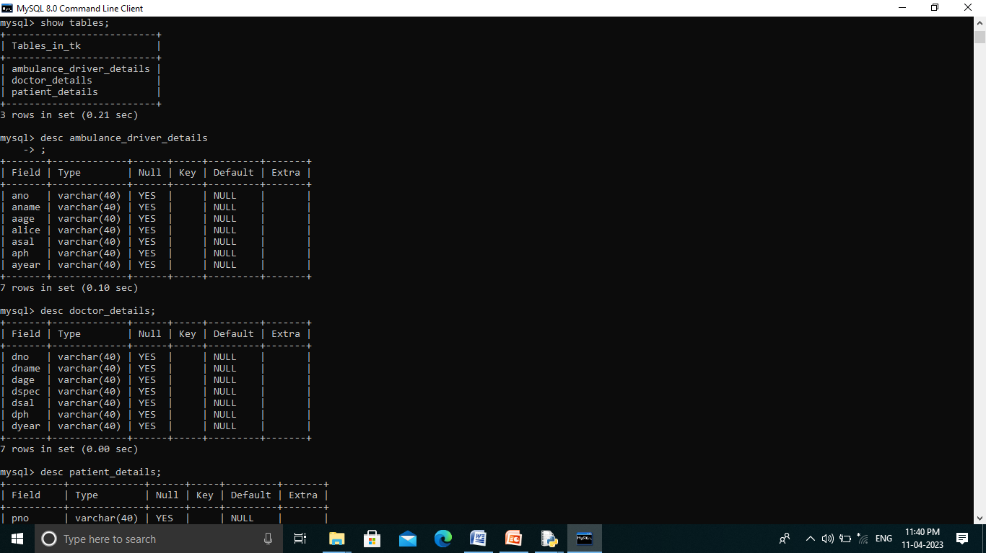
Tables used in my_sql description

Slide 12
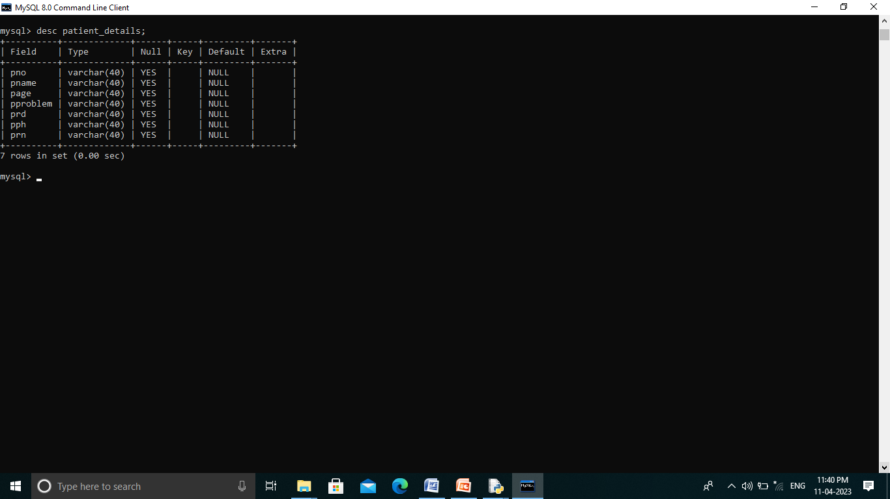

Slide 13
THANK YOU

